Slide 1
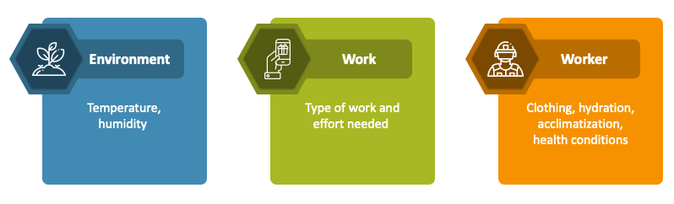
Personal Risk Factors in Heat Stress
Topics | Topics
Personal Risk Factors – PRFs | Heat Stress Questionnaire
4 Grouping of Personal Risk Factors | Pre-Work Personal Risk Assessment form
Highlights on the 4 Groupings of PRFs | Warning
Graphic - How Heat Affects the Body | OSHA’s Protecting Yourself
Graphic – Factors in Play | Signs & Symptoms and First Aid
Medical Conditions | Combined Risk Factors
Inter-relatedness of Risk Factors | Q&A

Slide 2
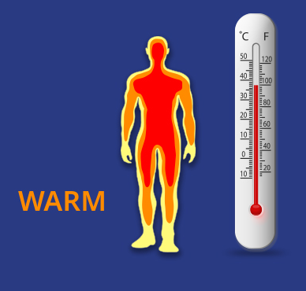
There is no such thing as a “normal” body temperature, so the 98.6 ºF is actually not really normal…
Humans actually run a bit cooler.
Adults over the age of 60 tend to have a lower body temperature, compared to younger adults. Babies and children have a wider range: 95.9 F to 99.5 F (if measured with an oral thermometer) or 97.9 F to 100.4 F (if measured by a rectal thermometer).
Scientists analyzed the oral temperature measurements of more than 126,000 adults seen at Stanford Health Care between 2008 and 2017.
They found the average human body temperature to be around 97.9 degrees, nearly a degree lower than 98.6.
The new study also finds variations in temperature depending on patient characteristics and time of day. For example, women tend to run hotter than men. Older people tend to have lower temperatures than younger people. And, among all demographics, temperatures tend to be lower in the morning and higher in the afternoon.
A normal temperature for adults is in the range of 97 F to 99 F.
For children, the normal temperature range is 95.9 F to 99.5 F
Fever in adults
There are different levels of severity of fevers in adults.
These include:
Low-grade fevers: 99.1 to 100.4 F
Moderate-grade fevers: 100.6 to 102.2 F
High-grade fevers: 102.4 to 105.8 F
If you're an adult with a fever of over 104 F, you should call your doctor.

Slide 3
DaveV Comment: People like simple for easy future reference…
a heuristic for those who prefer a technical sounding term for what most of us would default to calling a “rule-of-thumb.”
It is also possible that average body temperatures have dropped in recent decades because humans are getting healthier.
Thanks to advances in medicine and dentistry, patients are dealing with less inflammation than they likely were 150 years ago.
The new study also finds variations in temperature depending on patient characteristics and time of day. For example:
women tend to run hotter than men
Older people tend to have lower temperatures than younger people
temperatures tend to be lower in the morning and higher in the afternoon.
Since there’s so much variability in body temperature, a high reading for one person could be normal for someone else.
Individualized temperature evaluations and personalized fever thresholds might be more useful than comparing everyone to the average, the researchers say.
For example, a doctor might consider how a patient’s current temperature compares to their historical readings.

Slide 4
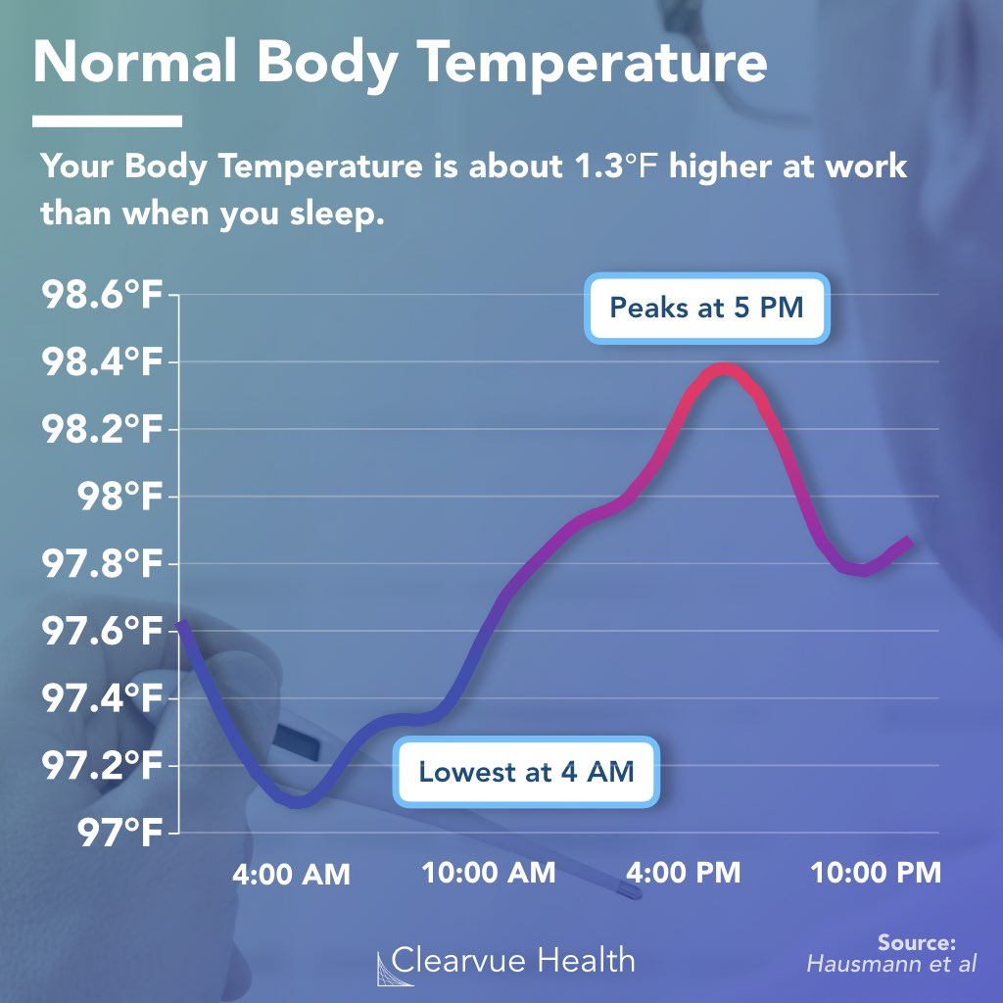
A lot of things can change your normal body temperature, making it higher or lower than 98.6 F.
These include:
How active you are
What time of day it is
The weather
Your age
Your sex
If you have any medical conditions
What you’ve eaten or had to drink
Where you are in your menstrual cycle
What body part or method you're using to measure the temperature
(Underarm readings can be a degree lower than mouth readings, and rectal temperatures are usually up to a degree higher than ones taken in the mouth.)

Slide 5
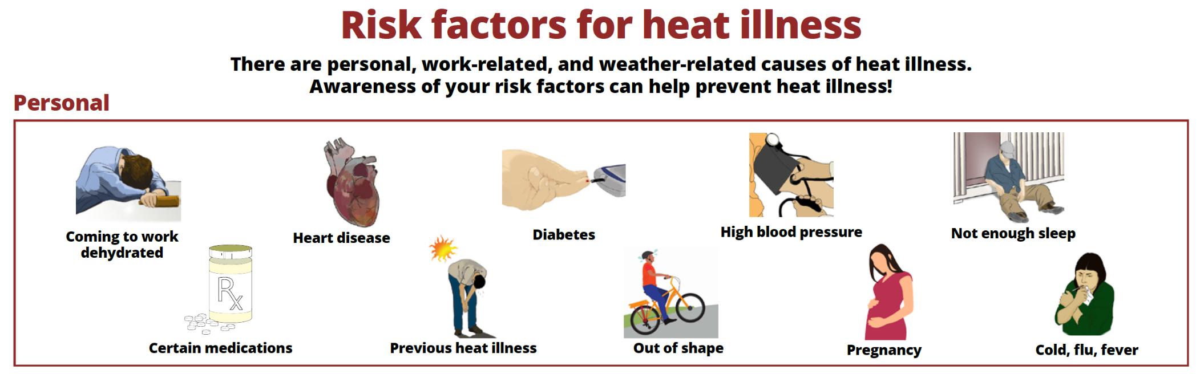
Personal Risk Factors for Heat Illness: (Per Cal OSHA)
Factors such as an individual's age, degree of acclimatization, health, water consumption, alcohol consumption, caffeine consumption, and use of medications that affect the body's water retention or other physiological responses to heat.

Slide 6
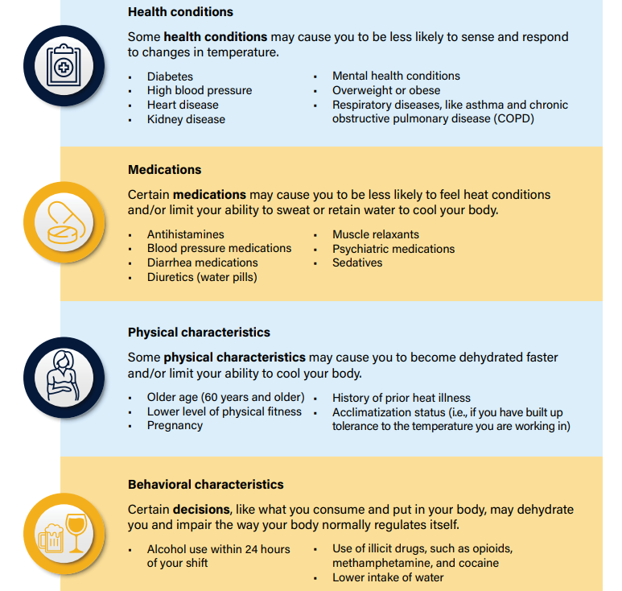
Personal Risk Factors that can reduce your tolerance to heat

Slide 7
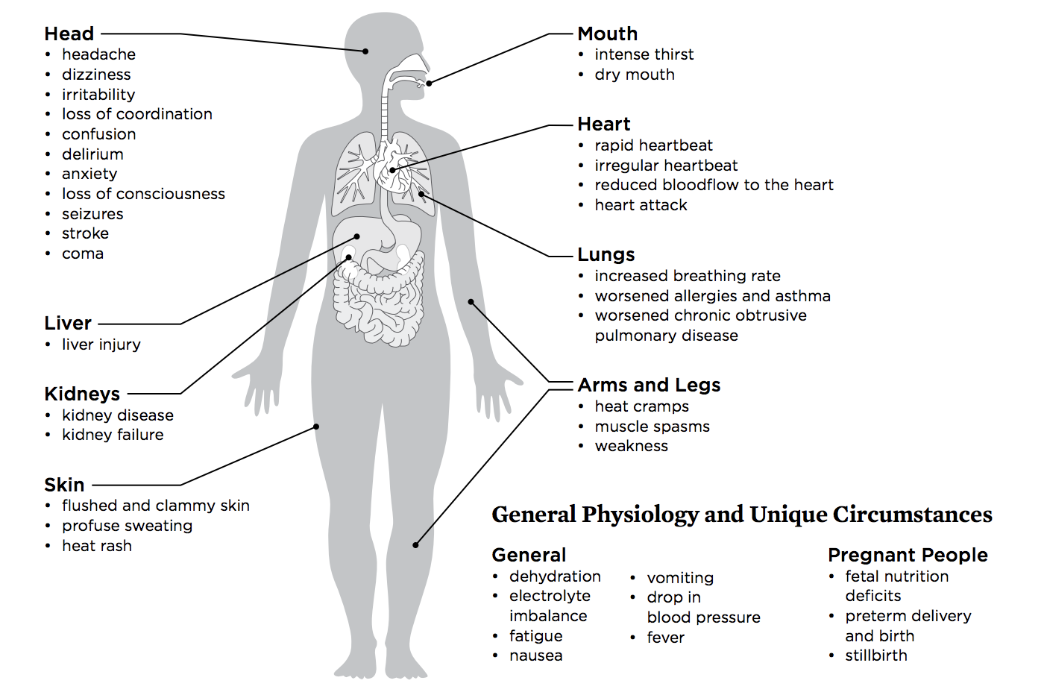
How Heat Affects Our Bodies

Slide 8
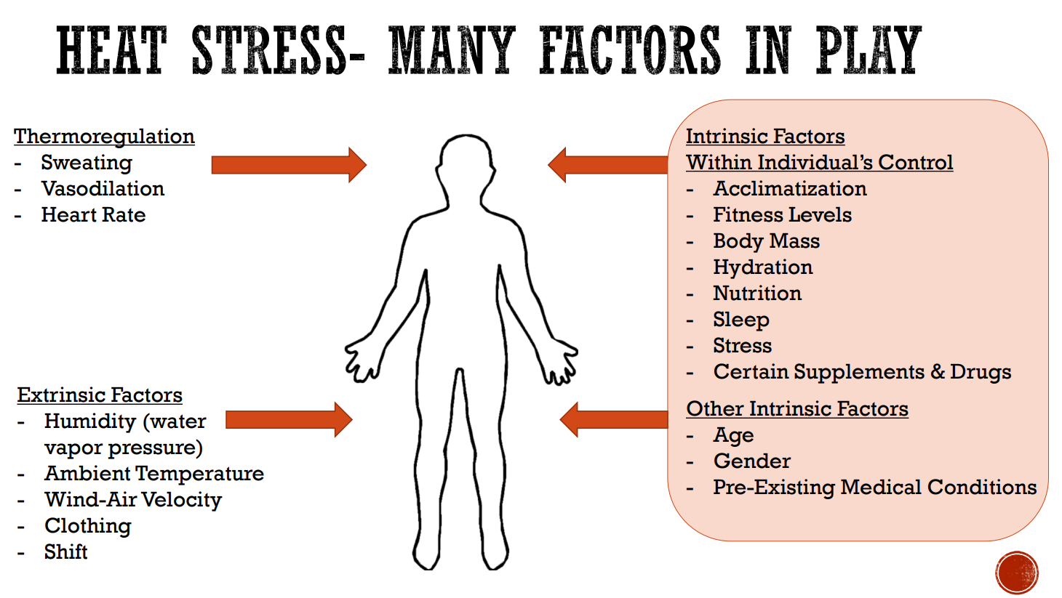

Slide 9
An Individual’s “Medical Conditions” can also predispose
that particular worker to experience a heat-related illness
Keep in mind that not all workers tolerate heat the same way.
Workplace controls should focus on making jobs safe for each individual employee.
An occupational medical monitoring program can identify workers who are at increased risk of heat illness, while maintaining confidentiality of those workers’ health information.
When heat hazards are present, workers should receive training about personal factors that can make them more susceptible to heat-related illness.
When in doubt, workers should talk to their healthcare provider about whether they can work safely in the heat.

Slide 10
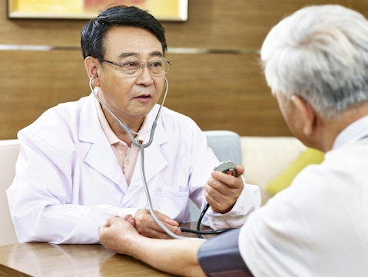
Most Workers with Chronic Conditions Haven’t Told Employer
Many workers who are suffering from chronic conditions are not telling their employers, according to a national poll, U.S. Employee Perspectives on Managing Chronic Conditions in the Workplace by the Harvard School of Public Health and de Beaumont Foundation.
The poll found that three-fourths (76%) of those with chronic conditions—such as hypertension, heart disease, diabetes, and asthma—need to manage their conditions during work hours.
Yet the majority (60%) have not formally disclosed their conditions to their employer.
While more than half of those polled, 58%, report having physical chronic health conditions, they are struggling with getting treatment and managing their jobs.
36% reported either skipping medical appointments or delaying care to avoid interfering with work in the past year.
And about half of those with chronic conditions say they felt they could not take time off work (49%) or take a break while at work (49%), even though they needed to because of their conditions.

Slide 11
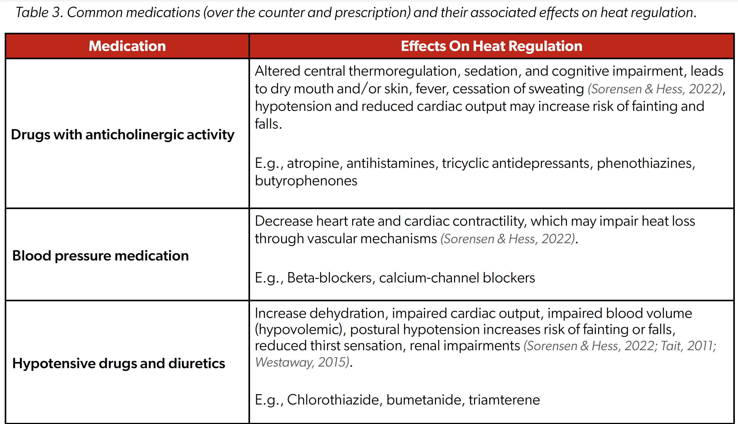

Slide 12
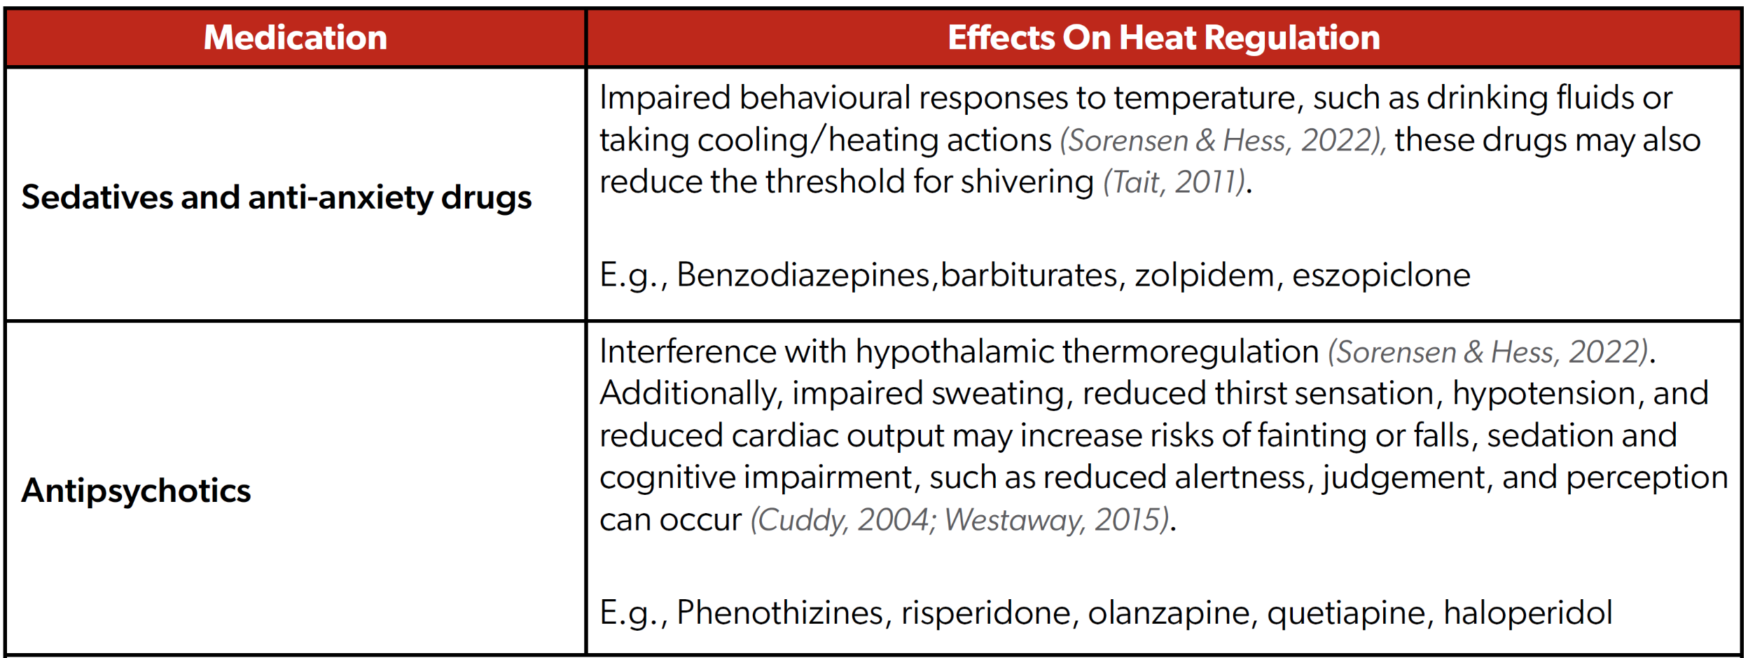

Slide 13
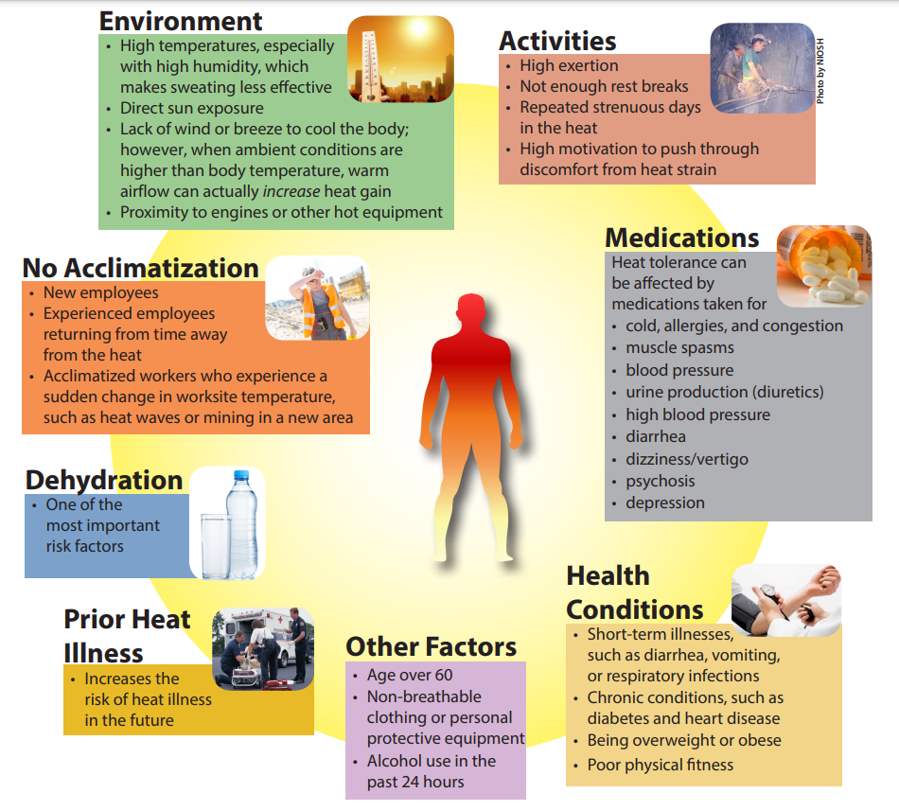
RISK FACTORS
Workers need to be aware of the many factors that can impact their risk of heat illness, but also that ---
workers can be affected by many risk factors at the same time.

Slide 14
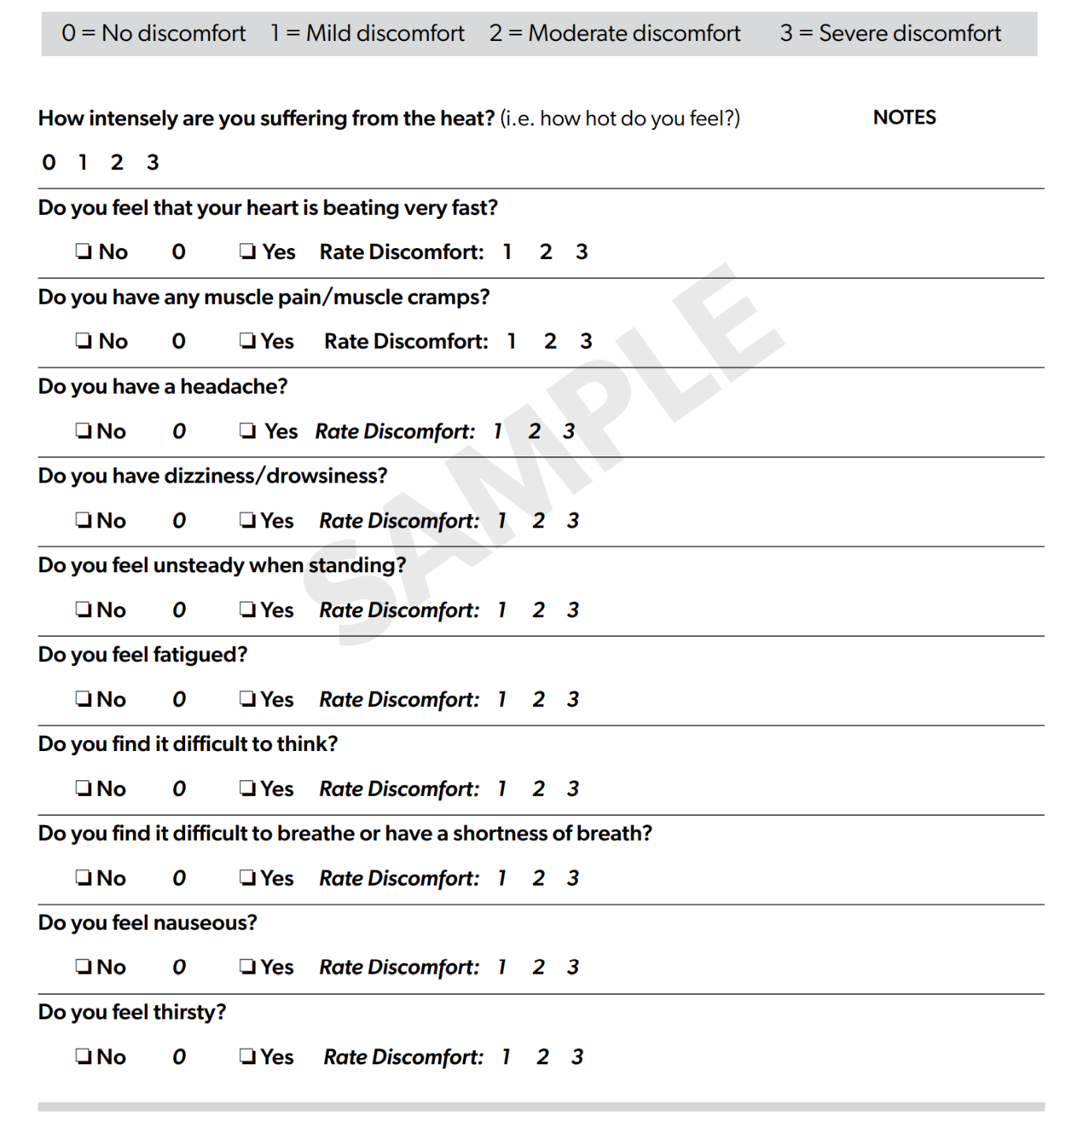
Heat Stress Screening Questionnaire
(for self or second-person monitoring)
Best Practice Recommendation
Post this in Rest Area or closest rest room
especially when you have passed the
High Heat Trigger

Slide 15
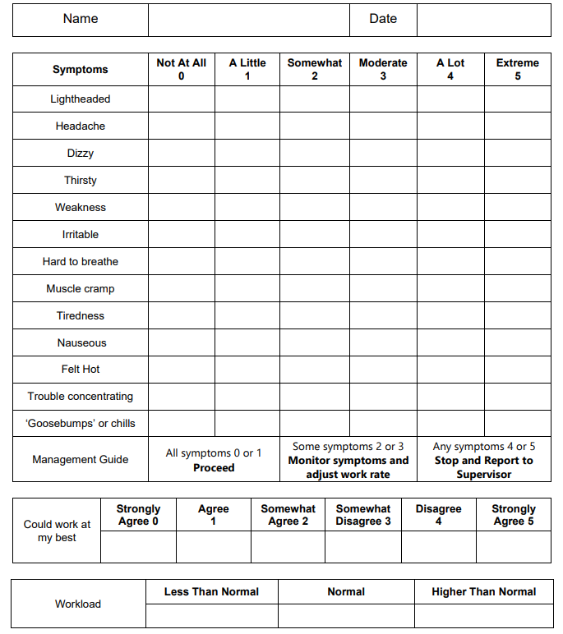
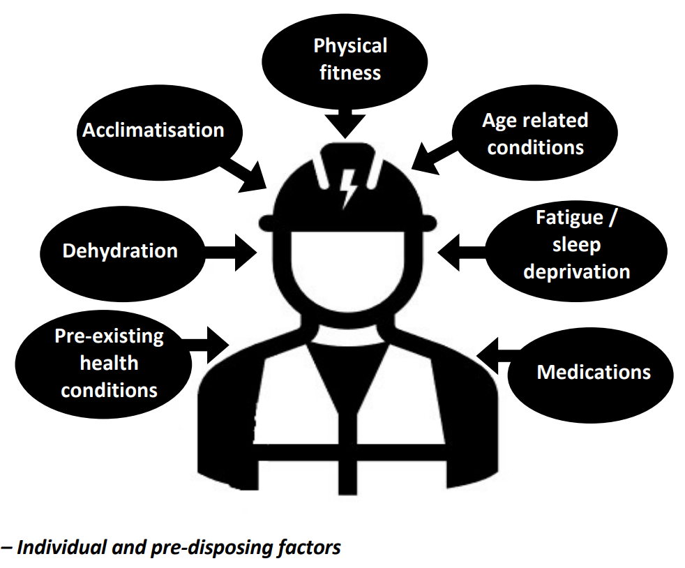
Symptoms Self-Assessment Questionnaire
Is your supervisor/HSC aware of medications currently being used that may impair your ability to perform duties in heat? □ Yes □ No

Slide 16
PRE-WORK CHECKLIST OF PERSONAL HEAT EXPOSURE RISK FACTORS
(NOTE: Provide a printed copy of Pages 5 and 6 to each individual in the work crew who will be directly engaged in this heat-involved work.)
Personal Risk Factors are provided under the physical and situational sub-factors, below.
Check boxes □ are provided so you can identify what you need to disclose and discuss with your designated Heat Stress Coordinator, who is required to know and to collaborate with you on what precautions & limitations to put in place that will prevent you from experiencing a heat-related illness.
Please take the time to read through this and evaluate what factors personally apply to you.
Physical Risk Factors
Obesity (body mass index > 30 kg/m²)
Diabetes
High blood pressure
Heart disease
Skin disorders (such as heat rash and sunburn that prevent effective sweating)
Advanced age (65+)

Slide 17
PRE-WORK CHECKLIST OF PERSONAL HEAT EXPOSURE RISK FACTORS
Situational Factors
Prior history of heat illness (a heat stroke or two or more episodes of heat exhaustion)
Use of certain medications (which can result in an inability to feel heat conditions and/or the inability to sweat, so symptoms of heat stress may not be evident)
  Diuretics (water pills) or dietary aids and some psychiatric or blood pressure medications
  Taking prescribed or over-the-counter supplements, cold remedies, stimulants, or performance-enhancing drugs, even energy boosting drinks
  A recent lack of quality sleep
  Your current state of hydration (be it from low fluid consumption or high alcohol consumption)
  Use of alcohol in the last 24 hours
  Lack of sustenance (not eating or dieting for extended period, before working in a hot environment)

Slide 18
Considerations (worth reviewing to keep in mind, for personally managing your own well-being)
Heat intolerance happens for a variety of reasons.
A worker may be affected by many risk factors at the same time.
The more factors, the higher the risk.
Along with workload, clothing & protective gear can reduce the body’s ability to cool itself.
Some workers handle heat stress less effectively than others, so do keep in mind that not all workers tolerate heat in the same way, because their medical conditions can also predispose them to heat-related illnesses
Physiological monitoring can identify workers who are at increased risk of heat illness, while maintaining confidentiality of those workers’ health information.
When in doubt, workers should talk to their healthcare provider about whether they can work safely in the heat.
Regardless, pay attention to your body, habits, and lifestyle when working in the heat.

Slide 19
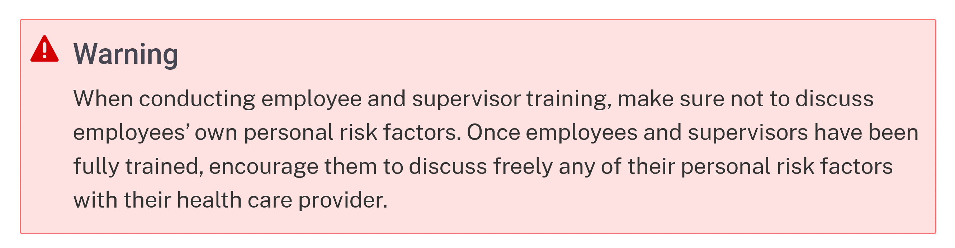
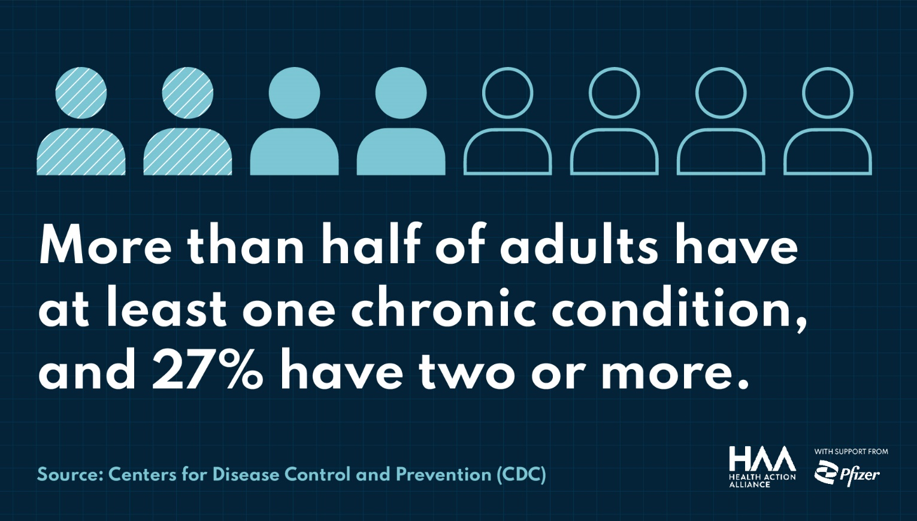

Slide 20
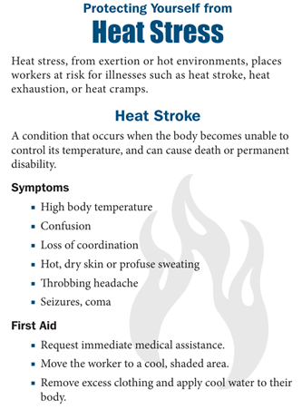
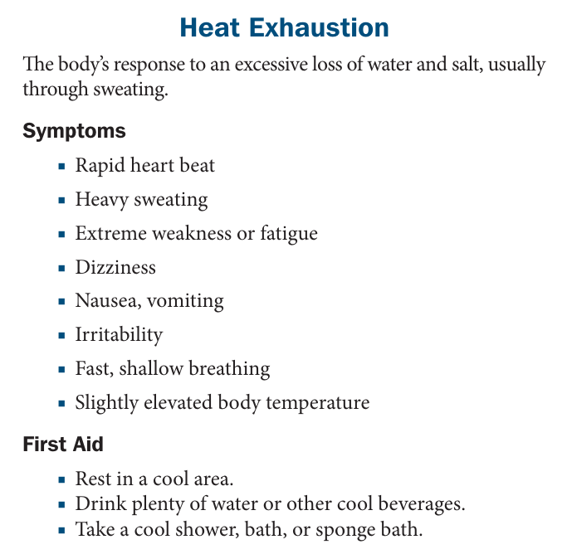
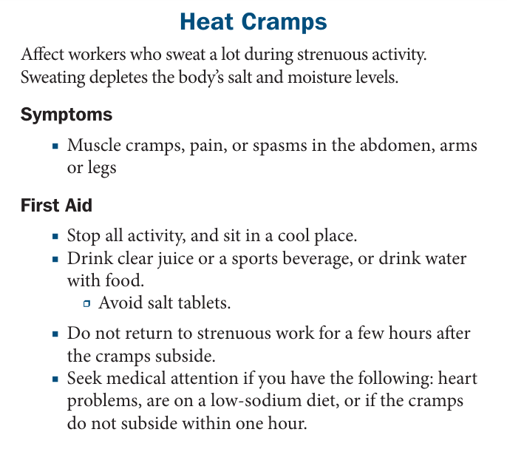
In conjunction with evaluating your own individual capabilities (i.e., self-assessing) against the recognized heat exposure risk factors that can impact your personal well-being, PLEASE READ through the Federal OSHA reminders below, to make sure that you are better prepared to keep in mind what you need to know and what you need to do, to “protect yourself from heat stress.”

Slide 21
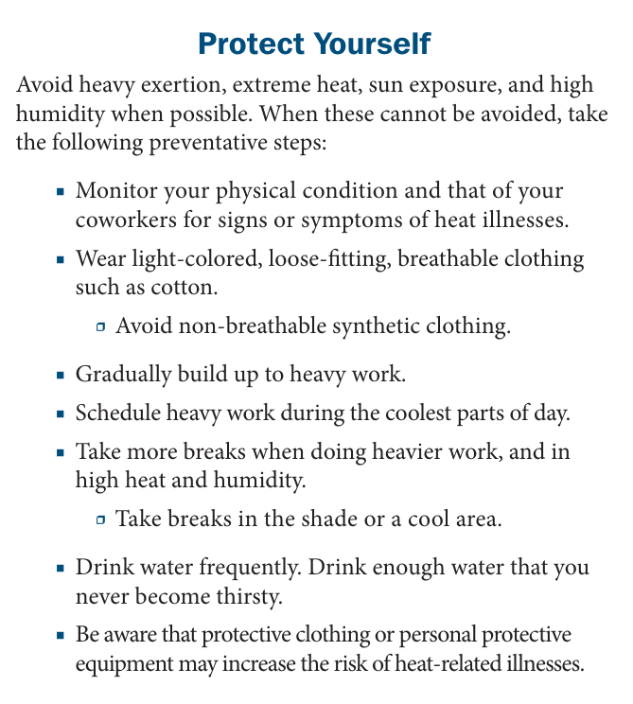
Recovery Actions (per ANSI A10-50-2024 recommendation)
Upon onset of the signs or symptoms of heat stress, inform job leader or assigned Heat Stress Coordinator of self-removal for recovery in rest area.
A heat stresses worker must remain there to rest & rehydrate until cleared to return to work, which is only permissible after spending at least 15 minutes in the rest area.

Slide 22
First Aid for Heat Illness: Signs & Symptoms and What to Do
Cooling is key, so:
Stop work;
Get to a cooler area; and
Hydrate –
are what to do if you should you feel or see one of your co-workers begin to show the signs or symptoms of heat illness.
Don’t ignore cramps or spasms in the stomach, arms, or legs, because your/ or a co-worker’s condition could degrade suddenly. And, NEVER leave a worker with heat illness alone.
Review the CDC/NIOSH table (next slide), keeping in mind that:
Symptoms can occur in any order, so you don’t need to have all of the symptoms in a category to be experiencing a heat illness.

Slide 23
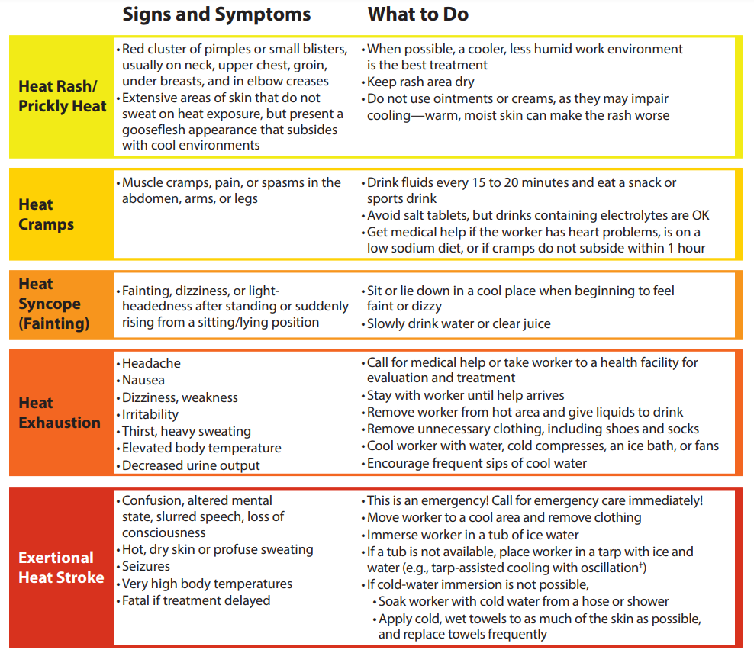
Recommended Best Practices:
Review the highlights of the five levels to heat illness in a pre-job briefing, including --
Review emergency response actions on who is responsible for first aid care and who is to call for help
Post this on the jobsite (preferably in the designated rest area) so workers can self-check
Consider staging an AED in rest area, especially if there is a worker with a known heart problem.

Slide 24
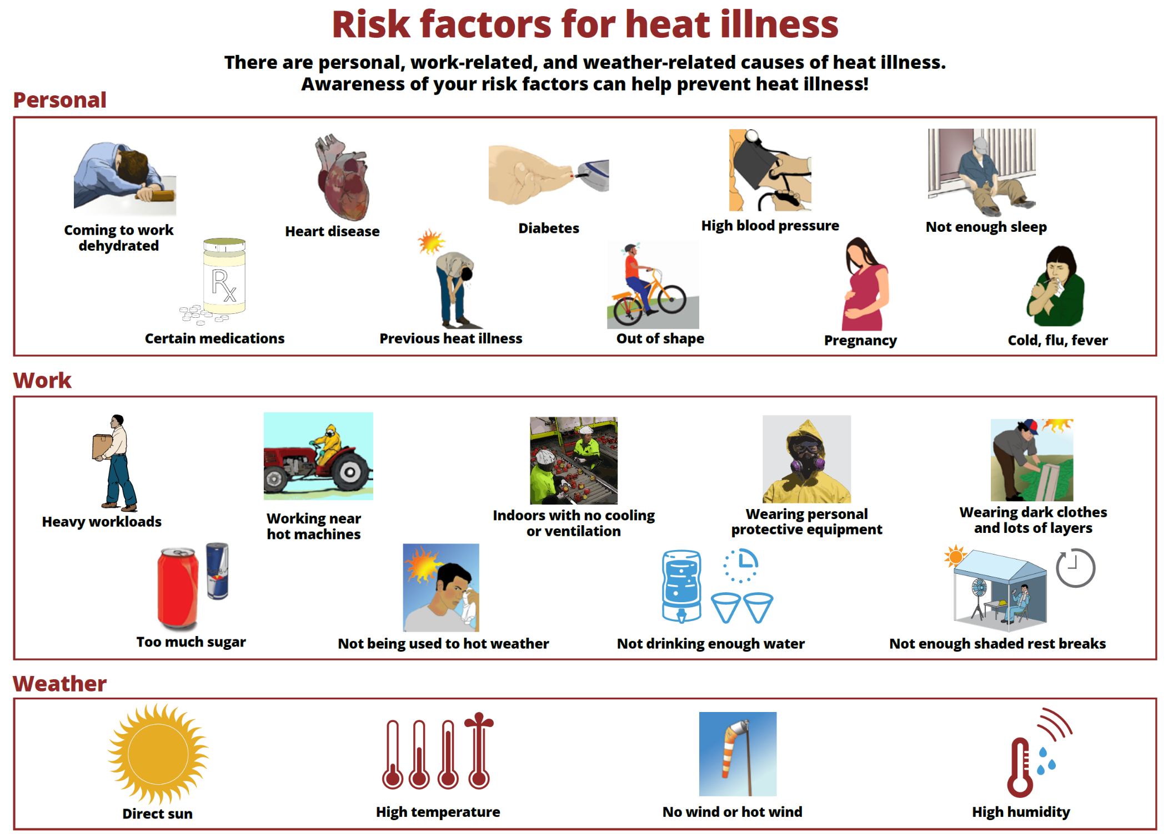

Slide 25
Science Stunner: People under 35, not seniors, most likely to die from heat
What if everything we thought we knew about who’s most at risk during extreme heat was wrong?
A new study turns conventional wisdom on its head, revealed that, in Mexico, it’s actually young people – not the elderly – who are dying more frequently from heat exposure.
The research shows that 75% of heat-related deaths occur among people under 35 years old, with many victims being otherwise healthy young adults.
Again, conventional wisdom has been that the elderly are more vulnerable to temperature extremes.
The study looked at 3,300 deaths per year over the period of 1998 - 2019, wherein those age 50 – 70 who were thought to be the most vulnerable had the lowest rates of heat-related deaths.
Why Mexico is that it had the data and of course the hot weather.
When WBGT reaches 95ºF it becomes more difficult to thermoregulate without artificial cooling because sweating is just not sufficient anymore.
Research led by R. Daniel Bressler (Columbia U.), and Andrew Wilson (Stanford U), supported by NOAA grant Dec 06, 2024

Slide 26
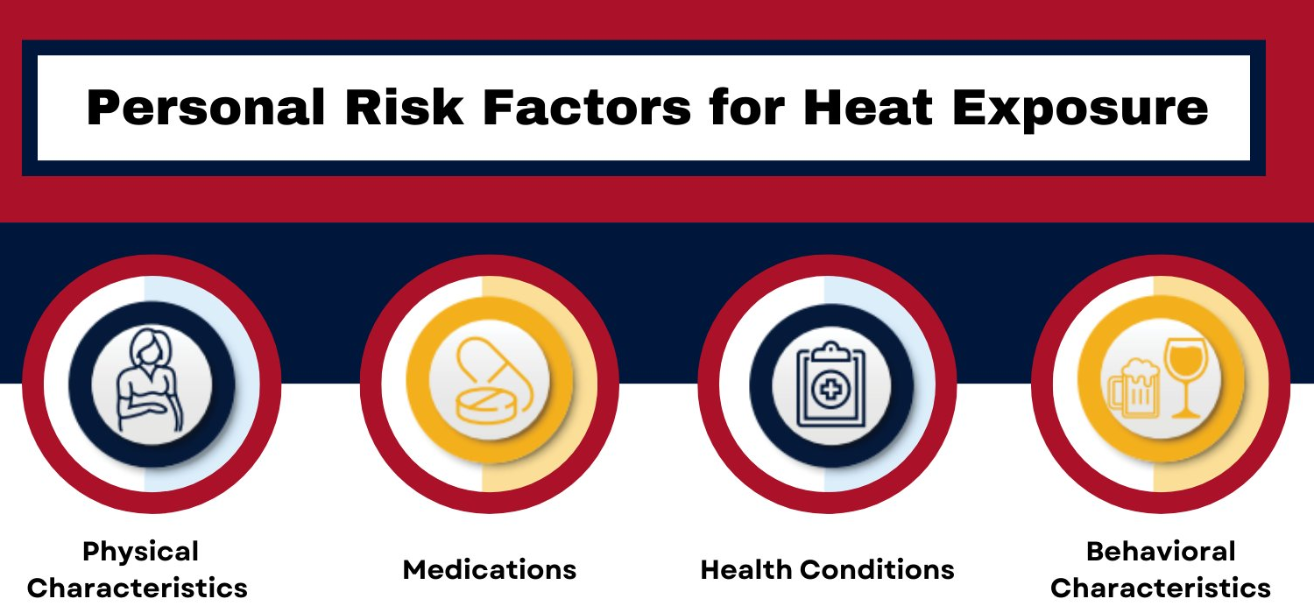
END

